Slide 1



Software Engineering GROUP 3 Shake and chat
王瀚磊 綦家志 李旭恩 王本奕 高睦修 陳立誠
指導教授：李允中 教授
Notes:
(王)

Slide 2
開會時間
 | 日 |  |  | 一 |  |  | 二 |  |  | 三 |  |  | 四 |  |  | 五 |  |  | 六
 | 早 | 中 | 晚 | 早 | 中 | 晚 | 早 | 中 | 晚 | 早 | 中 | 晚 | 早 | 中 | 晚 | 早 | 中 | 晚 | 早 | 中 | 晚
王瀚磊 | Ｏ | Ｏ | Ｏ | Ｏ | Ｏ |  | Ｏ |  | Ｏ | Ｏ | Ｏ | Ｏ | Ｏ |  | Ｏ | Ｏ | Ｏ |  | Ｏ | Ｏ
綦家志 |  | Ｏ | Ｏ |  |  | Ｏ | Ｏ |  |  |  | Ｏ | Ｏ |  | Ｏ |  | Ｏ | Ｏ
陳立誠 |  | Ｏ | Ｏ | Ｏ |  | Ｏ | Ｏ |  |  | Ｏ |  |  | Ｏ |  | Ｏ | Ｏ | Ｏ | Ｏ | Ｏ | Ｏ | Ｏ
李旭恩 |  |  | Ｏ | Ｏ | Ｏ | Ｏ |  |  | Ｏ |  |  | Ｏ | Ｏ | Ｏ |  |  |  | Ｏ
王本奕 | Ｏ | Ｏ | Ｏ |  | Ｏ |  | Ｏ |  | Ｏ | Ｏ | Ｏ | Ｏ | Ｏ |  | Ｏ
高睦修 | Ｏ | Ｏ | Ｏ | Ｏ |  | Ｏ | Ｏ |  | Ｏ | Ｏ |  | Ｏ |  |  | Ｏ |  |  | Ｏ | Ｏ | Ｏ | Ｏ
 | 3 | 5 | 6 | 4 | 3 | 4 | 5 | 0 | 4 | 4 | 3 | 5 | 4 | 2 | 4 | 3 | 3 | 3 | 3 | 3 | 2
Notes:
(王)

Slide 3
出席率
 | 9 /23線 | 9 /27 | 10/ 1 | 10/ 8線 | 10/ 11 | 10/ 15 | 10/ 22 | 10/ 29 | 11/ 1線 | 11/ 3益華 | 11/ 5 | 11/ 7 微軟 | 11/ 8 | 11/ 10群暉 | 11/ 13 | 11/ 26 | 12/ 3 | 12/ 8線 | 12/ 10線 | 12/ 17線 | 12/ 29線 | 1 / 5 | 1 / 7
王瀚磊 | O | O | O | O | O | O | O | O | O | O | O | O | X | O | O | O | O | O | O | O | O | O | O | 22/ 23
綦家志 | O | O | O | O | O | O | O | O | O | O | O | O | O | O | O | O | O | O | O | X | O | O | O | 22/ 23
陳立誠 | O | O | O | O | X | X | O | X | O | O | O | O | X | O | O | O | O | X | X | O | X | O | O | 16/ 23
李旭恩 | O | O | O | X | O | O | O | X | O | O | O | O | O | X | O | O | O | X | X | O | O | O | O | 18/ 23
王本奕 | 未加入 | O | O | O | O | O | O | O | O | X | O | O | O | X | O | X | O | O | O | O | O | O | O | 19/ 22
高睦修 | 未加入 | O | O | O | O | O | O | O | O | O | O | O | O | O | O | O | O | O | O | X | O | O | O | 21/ 22
Notes:
(王)

Slide 4
選擇IM
9/23 選擇Zulip
10/8 放棄Zulip
Build不起來
10/8 選擇Telegram
10/11 放棄Telegram
沒有Server端
10/11 選擇XMPP協定的Conversation
10/15 回歸Zulip
Notes:
(王)
沒server端，geo-handler很難寫。

Slide 5
Coding貢獻表
前端
神仙 王瀚磊
搖一搖 王瀚磊 李旭恩 陳立誠
位置 王瀚磊 李旭恩
地圖 王瀚磊 高睦修 王本奕
Bonus 王瀚磊 李旭恩
Score 王瀚磊 李旭恩 王本奕
整合 王瀚磊 李旭恩
後端
小囉囉 綦家志
Notes:
(王)

Slide 6
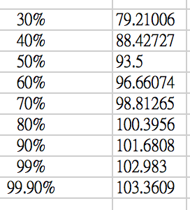
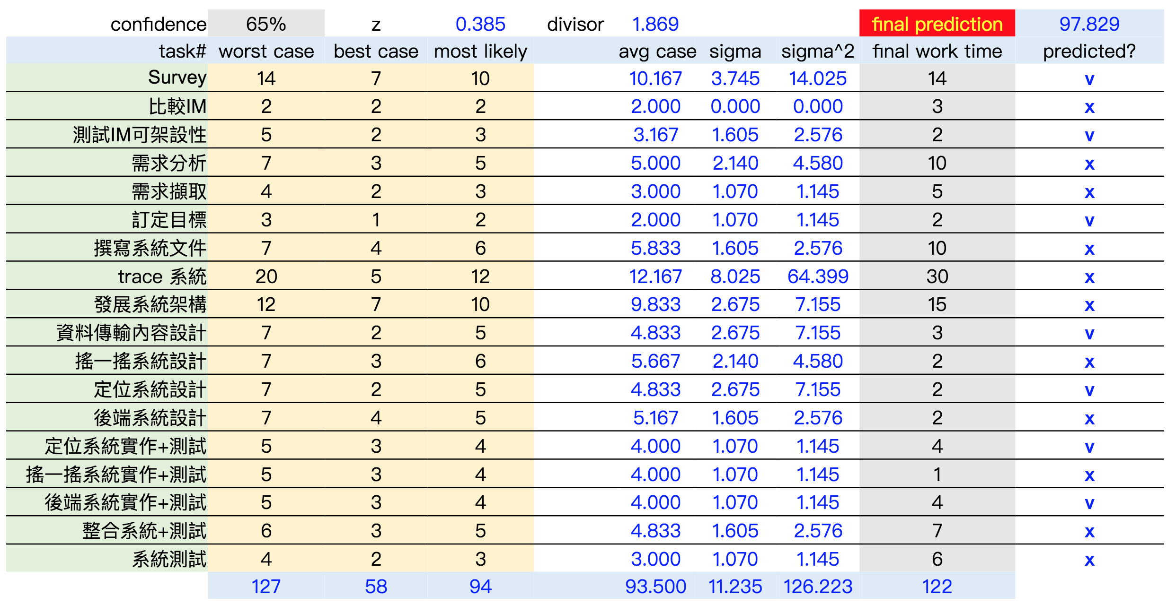
WBS
Notes:
(家)

Slide 7
Milestone
編號 | 里程碑項目 | 預期完成 | 實際完成
M1 | 決定IM與應用 | 2017/10/15 | 2017/10/15
M2 | 需求文件產出 | 2017/10/24 | 2017/11/8
M3 | 設計文件產出 | 2017/11/7 | 2017/12/4
M4 | 模組驗收 | 2017/11/21 | 2017/12/31
M5 | 系統原始碼產出 | 2017/12/12 | 2018/1/7
M6 | 測試文件產出 | 2017/12/19 | 2018/1/7
M7 | 驗收測試 | 2017/12/26 | 2018/1/7
Notes:
(旭)

Slide 8
工具介紹
本專案使用的即時通訊系統為Zulip
資料庫為Postgre SQL 9.1
程式語言為Python3.5.2
環境為Ubuntu 16.04
手機client端使用Android Studio3.0.1 開發
使用套件包含Android SDK API24 (minSDK 14)
Google APIs
Google Play Services
版本控制使用Gitlab
Django1.8
Notes:
(旭)
Zulip用到的工具

Slide 9
知識技能需求
專業知識技能 | 人數 | 預計受訓人員 | 說明
Zulip Client | 3 | 王瀚磊 李旭恩 高睦修 | 本專案所套用之Instant Messenger，其client端原始API之應用與熟悉
Zulip Server | 3 | 綦家志 王本奕 陳立誠 | 本專案所套用之Instant Messenger，其server端原始API之應用與熟悉
Google Map API | 6 | 全體 | 在client端(mobile)上之定位系統係透過google map之API取得其定位資訊，讓 API 從全球定位系統 (GPS) 及 WiFi 與手機基地台訊號資料等可用的位置提供者，儘可能測定最精確的位置
Android Studio 3 | 6 | 全體 | Client端之應用皆採用Android Studio 3作為開發平台，因此全員需在專案進行前熟悉此開發工具
Python 3程式設計 | 6 | 無 | 本專案的成員已有相關經驗
PostgreSQL 9.1 | 2 | 全體 | Zulip Server端所使用之database，由於新增之定位功能需仰賴資料庫之擴充欄位及搜尋等功能，因此全員需在專案進行前熟悉此工具
Notes:
(旭)

Slide 10
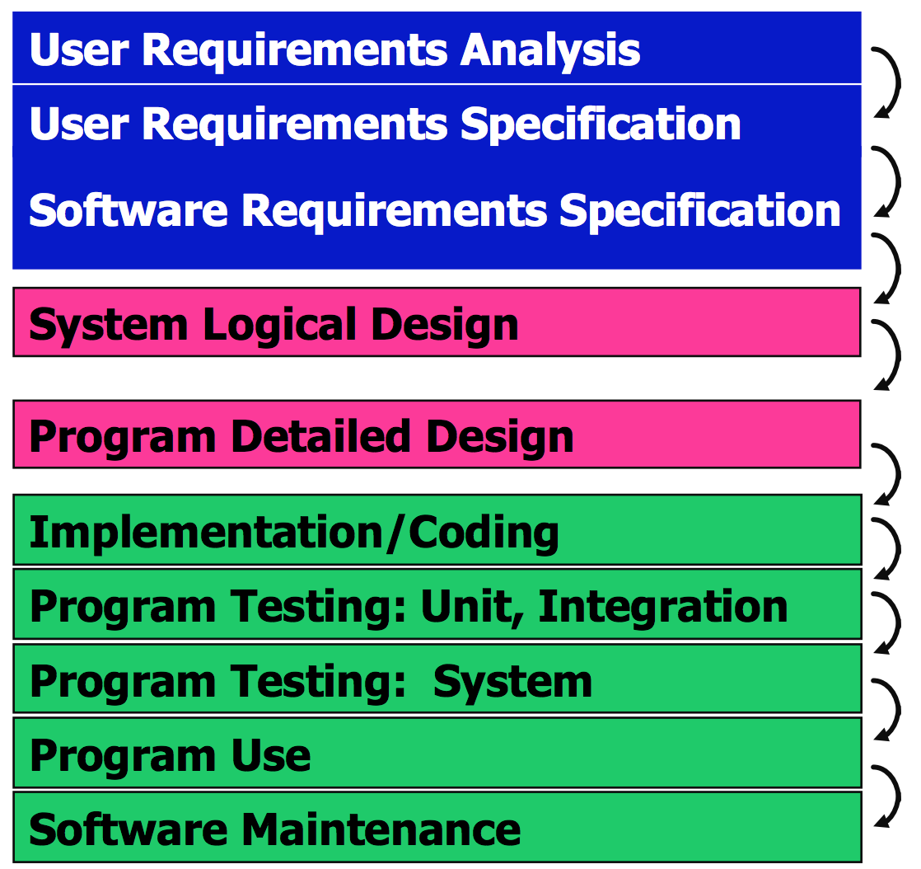
開發流程
Work Breakdown Structure
Project Estimation Plan
前期：Waterfall
需求穩定
Software Design Description
Notes:
(旭)

Slide 11
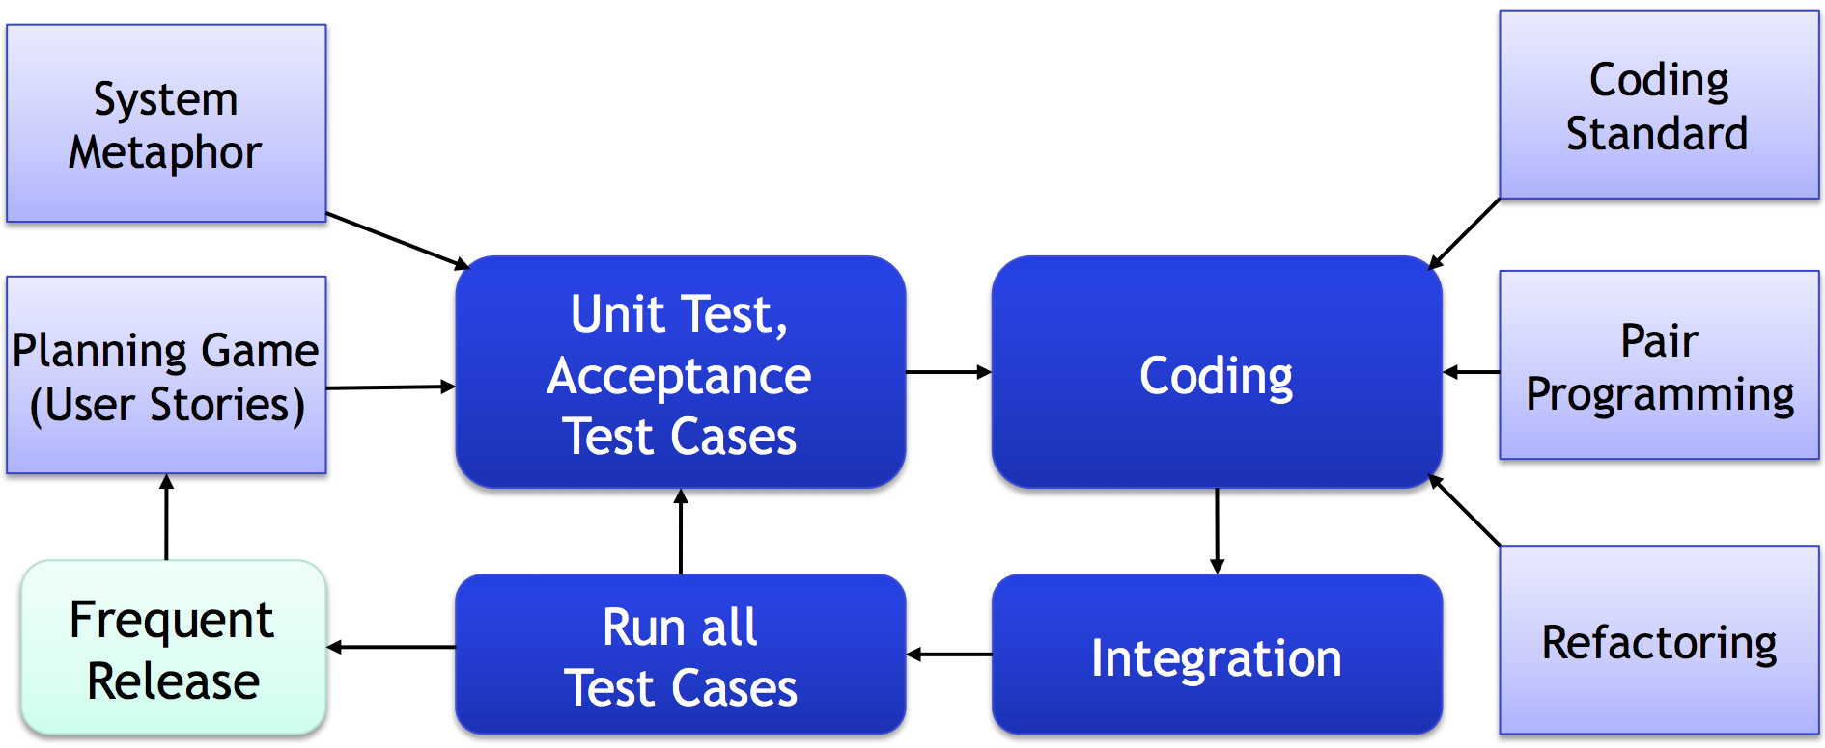

開發流程
後期：Extreme programming
Notes:
(旭)

Slide 12
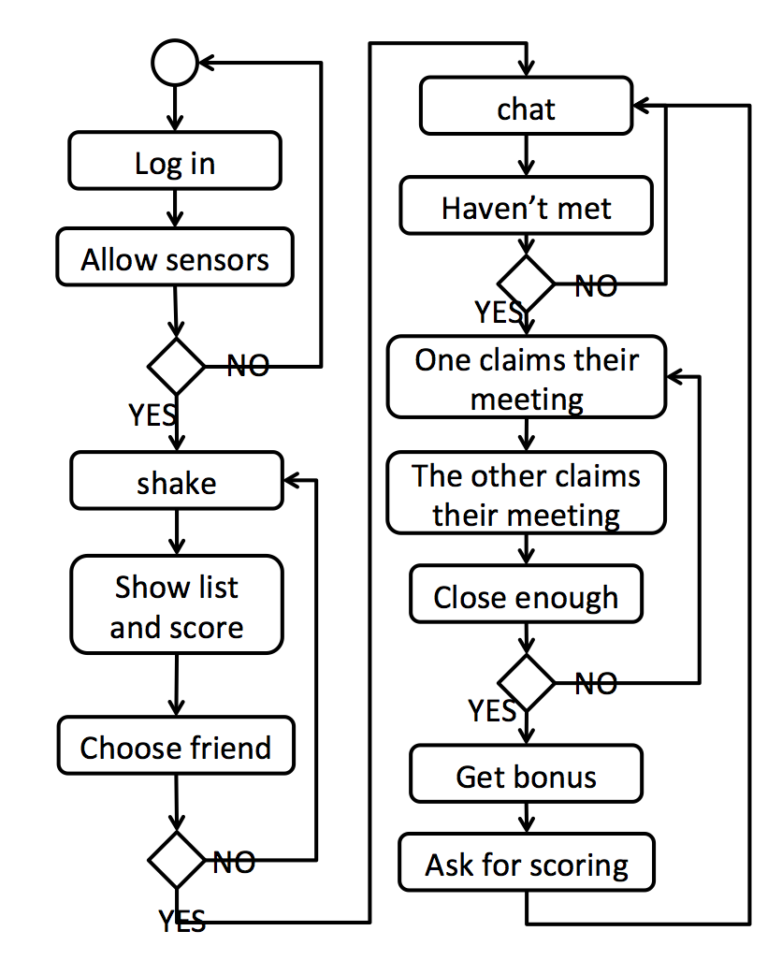
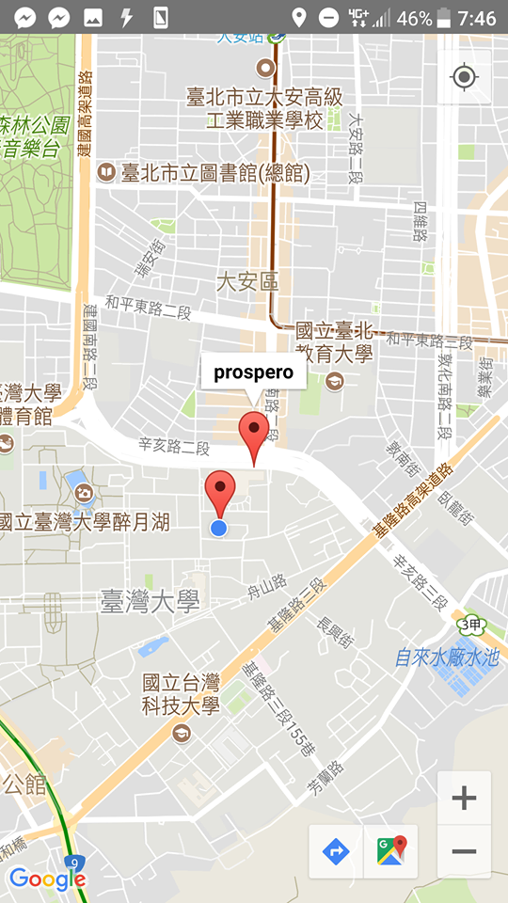
Process Diagram
Notes:
(立)

Slide 13
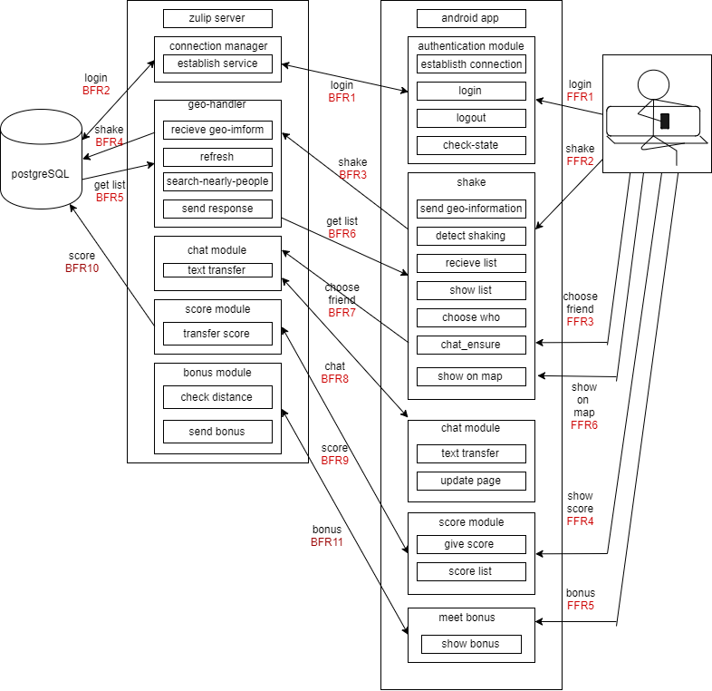
System Architecture
Notes:
(高)

Slide 14
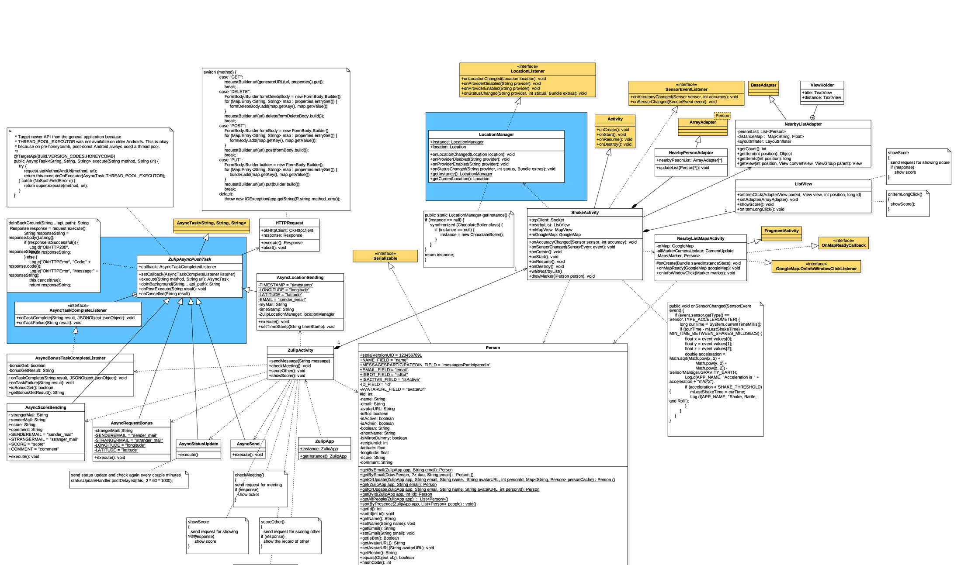
Front-end Class Diagram
Notes:
(神)

Slide 15
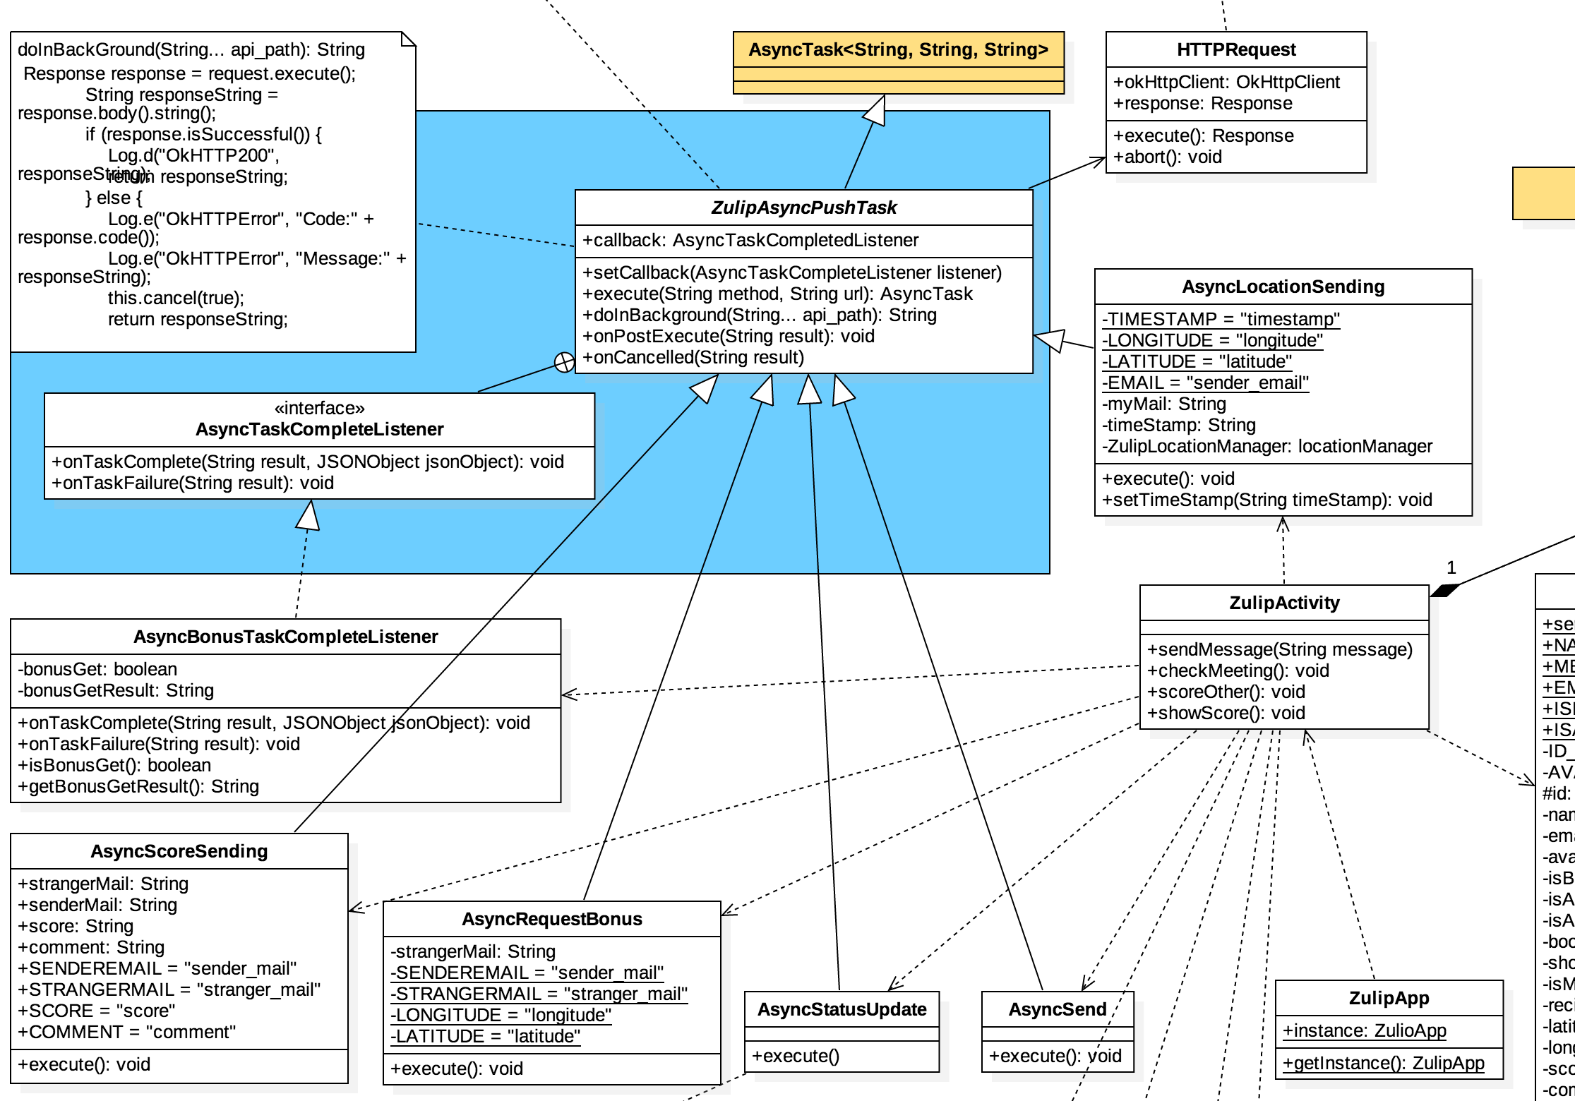
Front-end Class Diagram(left)
Notes:
(神)

Slide 16
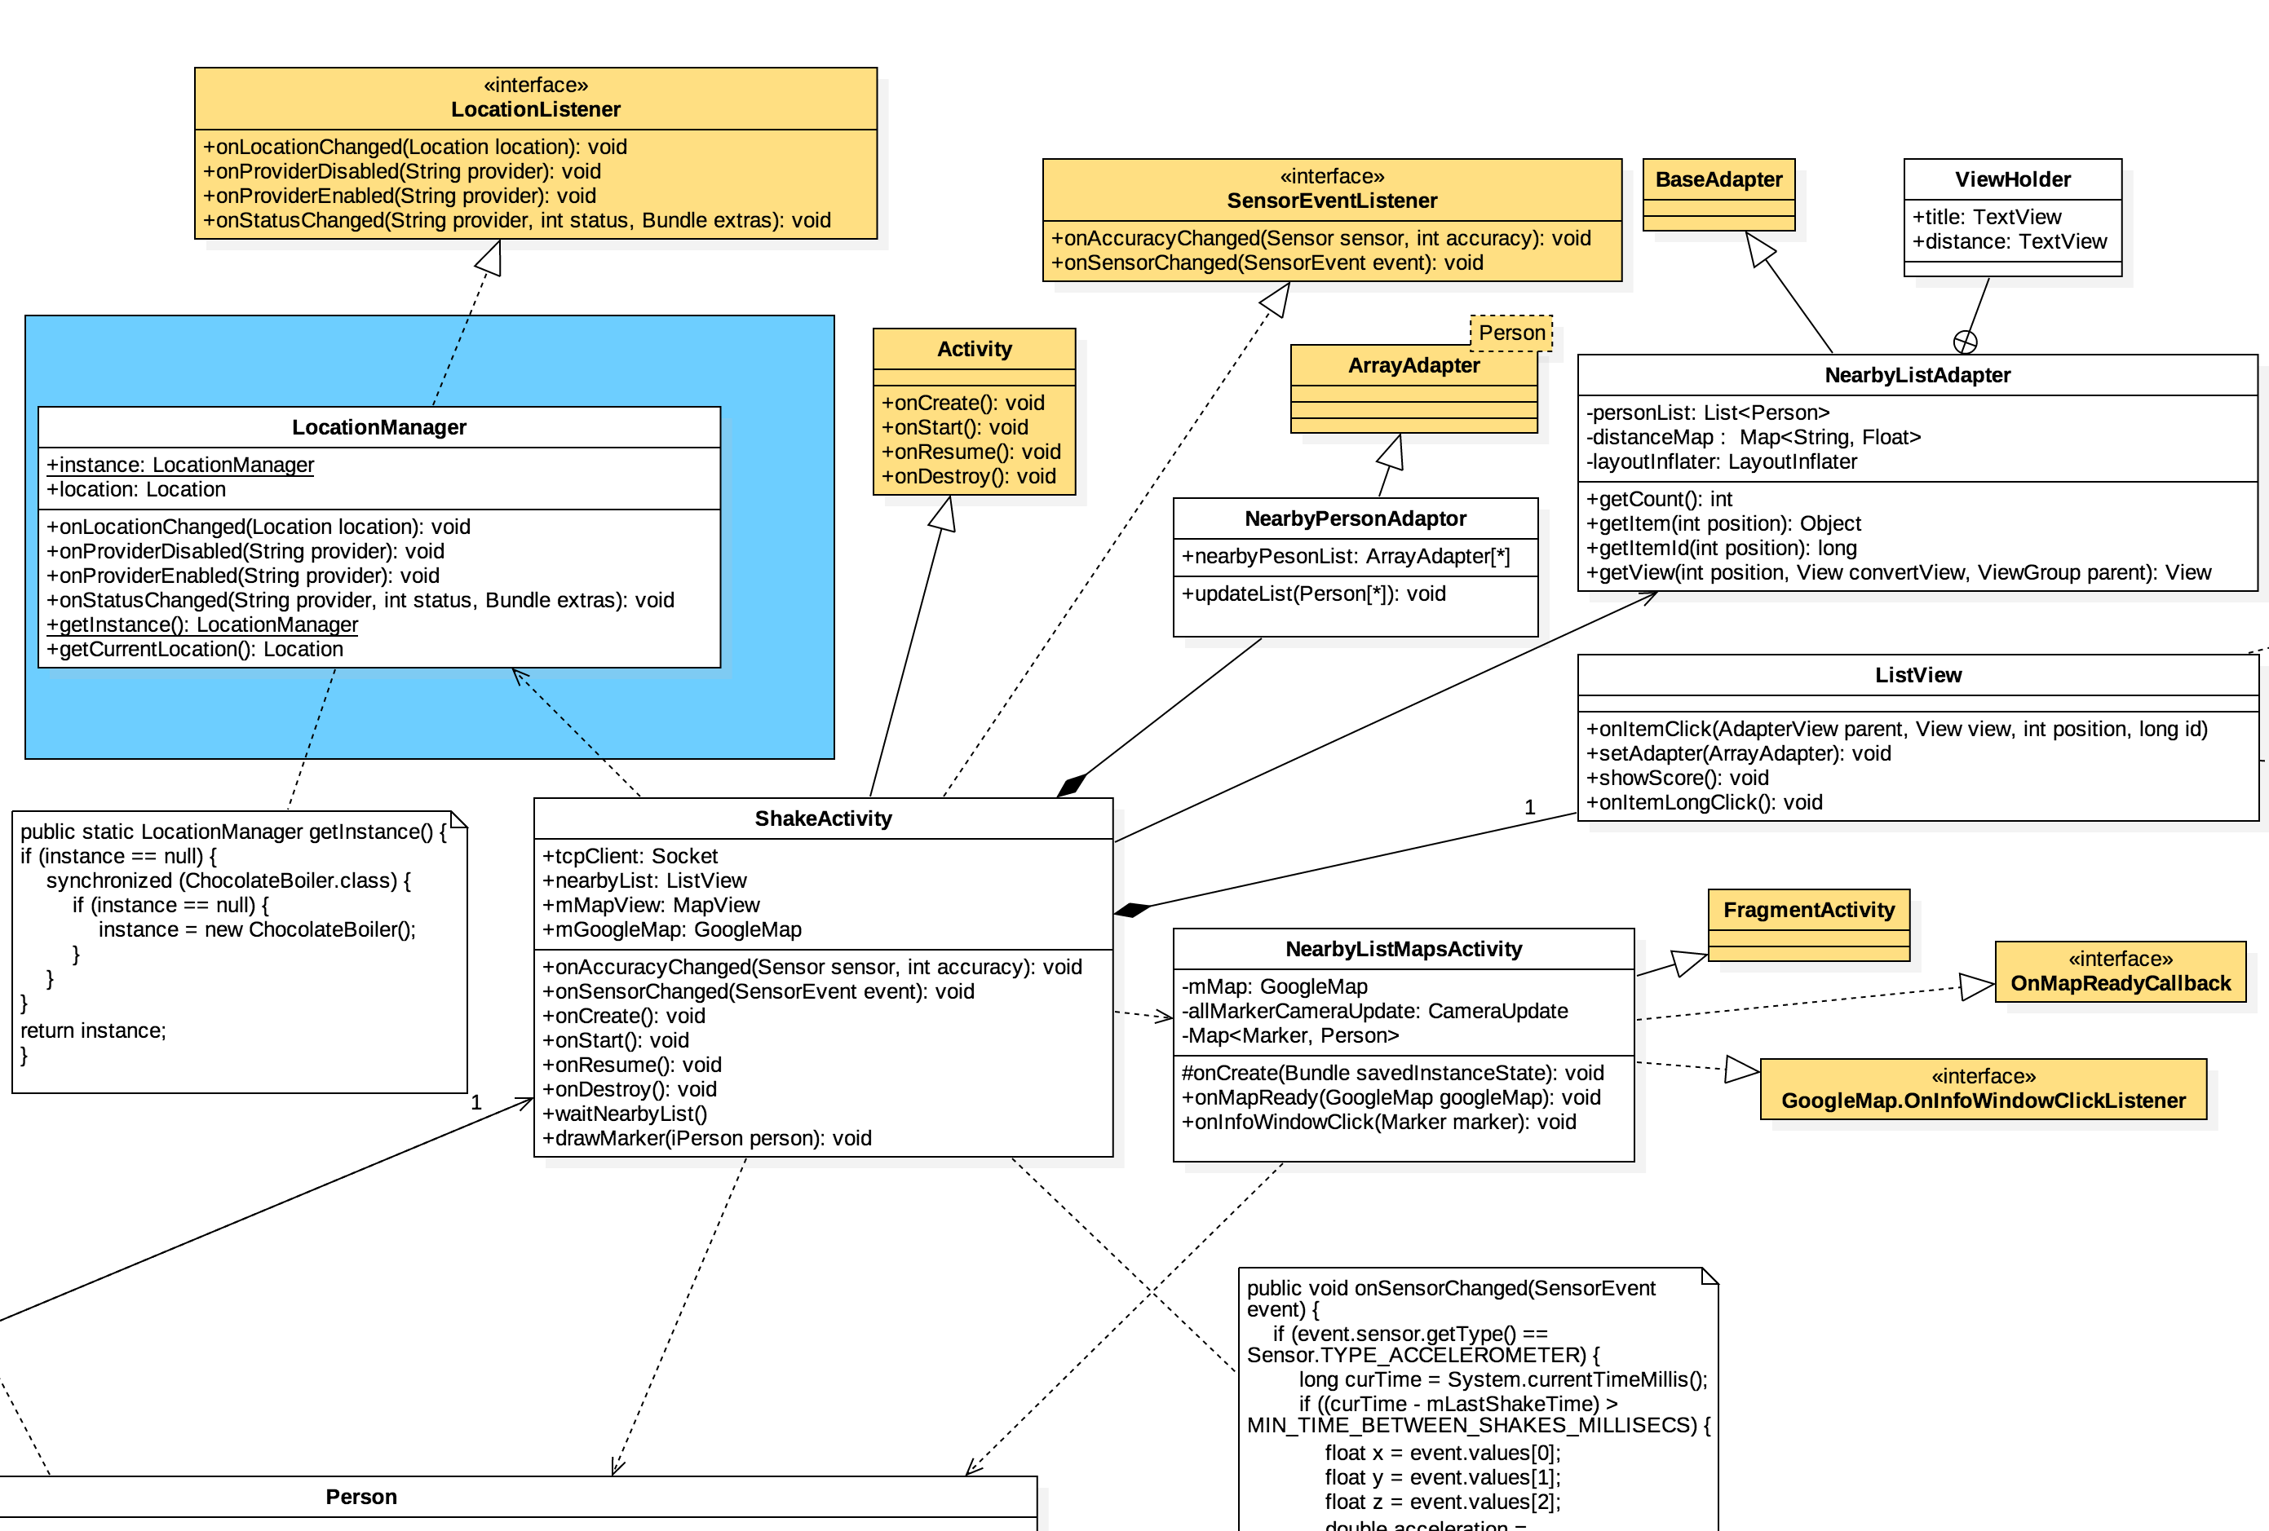
Front-end Class Diagram(right)
Notes:
(神)

Slide 17
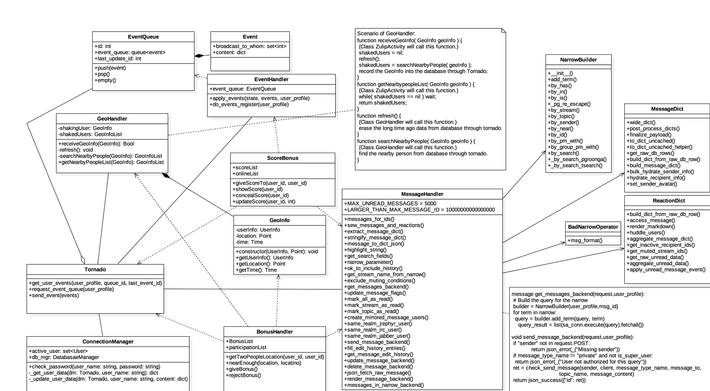
Back-end Class Diagram
Notes:
(家)

Slide 18
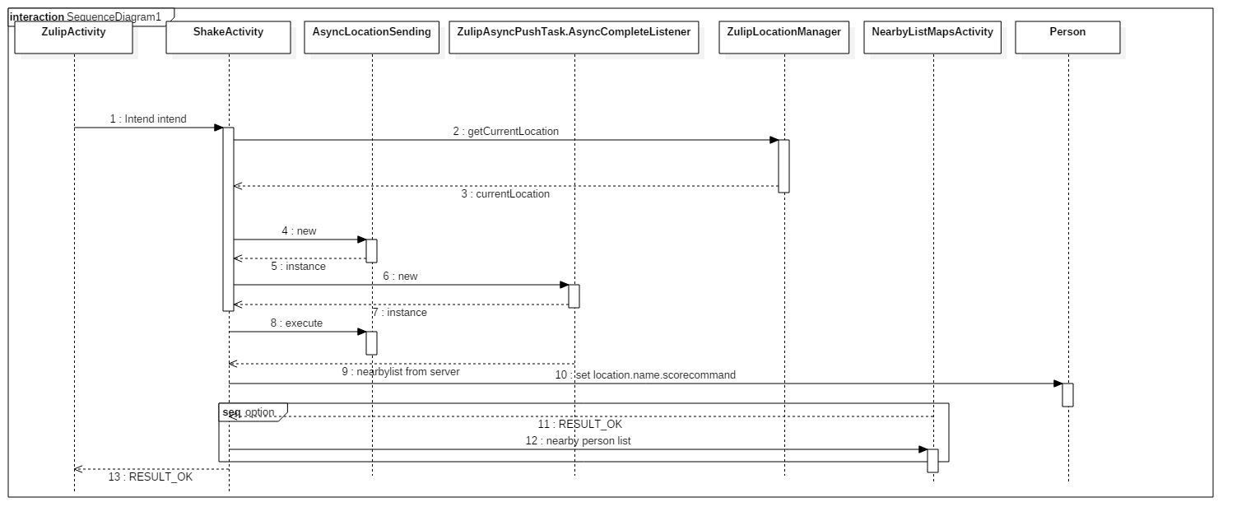
Sequence Diagram
Shake
Notes:
(高)

Slide 19
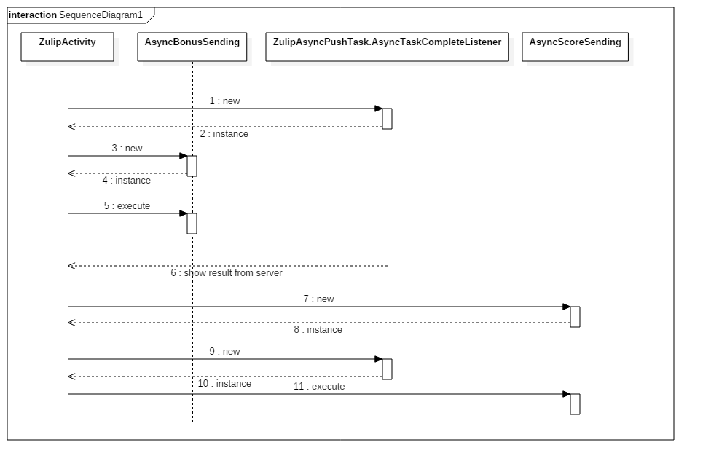
Sequence Diagram
Bonus and score
Notes:
(高)

Slide 20
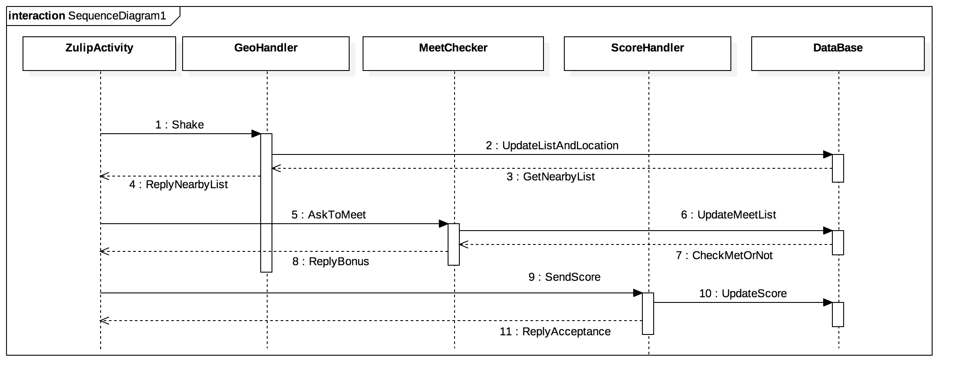
Sequence Diagram
Backend
Notes:
(家)

Slide 21
Front-End Test Case
Test Case # | Use Case # | Description | Unit Test | Integration Test | Deploy Test
001 | 001 | Update state/date after login. | V | V | V
002 | 002 | Detect shake in multi times. | V | V | V
003 | 002 | Send location/mail/time stamp to server each 5 seconds. | V | V | X
004 | 002 | Each time stamp is fixed as the first time’s current time. | X | V | V
005 | 002 | Get current location. | V | V | X
006 | 002 | Parse nearby list from server (UTF-8). | - | X | V
007 | 003 | Show the nearby user via list view. | V | V | V
Notes:
(神)

Slide 22
Front-End Test Case
Test Case # | Use Case # | Description | Unit Test | Integration Test | Deploy Test
008 | 003 | Long click to show the score/comment. | V | V | V
009 | 004, 005 | Click to return chosen person in ZulipActivity for chatting. | V | V | V
010 | 008 | Click to ask for bonus information from server. | - | V | V
011 | 008 | If first time receive bonus, score the stranger. | - | X | V
012 | 009 | Let the user to edit score and comment after getting first time bonus. | - | V | V
013 | 009 | Send score comment stranger mail to server. | V | V | V
Notes:
(神)

Slide 23
Front-End Test Case
Test Case # | Use Case # | Description | Unit Test | Integration Test | Deploy Test
014 | 010 | MapActivity receive nearby list from ShakeActivity intent. | V | V | V
015 | 010 | Show the current location when clicking ‘where am I’. | V | V | X
016 | 010 | Show all the nearby person marker on the map in the same time. | V | V | X
017 | 010 | Return chosen person to ShakeActivity. | V | V | V
018 | 005, 010 | Return chosen person to ZulipActivity for chatting. | V | V | V
Notes:
）(神)

Slide 24
Front-End Test Case Result
 | Pass # | Total # | Accuracy
Unit Test | 13 | 14 | 92.85%
Integration Test | 15 | 18 | 83.33%
Deployment Test | 15 | 18 | 83.33%
Notes:
(神)

Slide 25
Back-End Test Case
Test Case # | Use Case # | Description | Unit Test | Integration Test | Deploy Test
001 | 003 | One send a shaken message but no others shaken. | V | V | V
002 | 003 | Two people send shaken message sequentially and the distance is near enough. | V | V | V
003 | 003 | Three people send shaken message sequentially, two of them are near but the other is not. | V | V | V
004 | 003 | Three people send shaken message sequentially, all of them are near enough | V | V | V
005 | 003 | Two people send shaken message sequentially, they are near enough but the time between messages is too long. | V | V | V
006 | 003 | A people send a met message before send a shaken message. | - | X | V
Notes:
(家)

Slide 26
Back-End Test Case
Test Case # | Use Case # | Description | Unit Test | Integration Test | Deploy Test
006 | 008 | One send a met message but the other don’t | V | V | V
007 | 008 | Two people send met message but not near enough | V | V | V
008 | 008 | Two people send met message and near enough | V | V | V
009 | 008 | Two people that have met before send met message. | V | V | V
010 | 008 | Use the exact location to see if the distance is accurate enough. | V | V | V
Notes:
(家)

Slide 27
Back-End Test Case
Test Case # | Use Case # | Description | Unit Test | Integration Test | Deploy Test
011 | 009 | One send a score and a comment. | V | V | V
012 | 009 | One send a score that is not a valid number | X | V | V
013 | 009 | One send a comment with Chinese. | - | - | X
014 | 009 | Two people send score and comment to the same person. | V | V | V
015 | 009 | Three people send score and comment to others. | V | V | V
Notes:
(家)

Slide 28
Back-End Test Case Result
 | Pass # | Total # | Accuracy
Unit Test | 12 | 13 | 92.3%
Integration Test | 13 | 14 | 92.85%
Deployment Test | 14 | 15 | 93.33%
Notes:
(家)

Slide 29
Risk
人事異動
開源軟體架設困難
Android Studio
Requirement改動
系館衛生
GPS
Notes:
(立)
Android Studio名稱不能取太長
系館有蟑螂
解決方式：旭恩
吹捧老師神預測 GPS果然會飄 老師好厲害
解決方式：用網路存取位置 去戶外

Slide 30
Demo
Notes:
(王)

Slide 31

Discussion
Process improvement
WBS Schedule Delay
Shower
Influence between codes and documents
Notes:
（立）
冷水澡洗不夠 導致瀚磊久病不癒

Slide 32
End
Thank You
Q & A

Slide 33
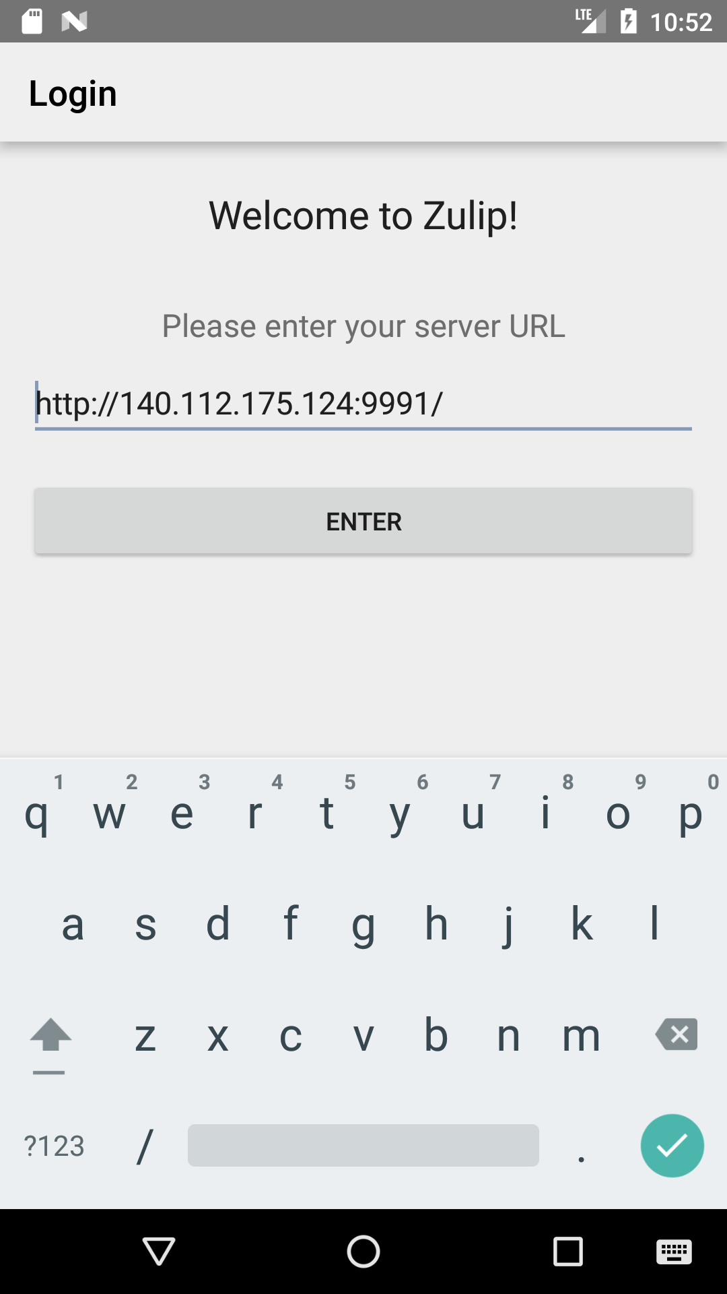
Demonstration(/)
serverUI

Slide 34
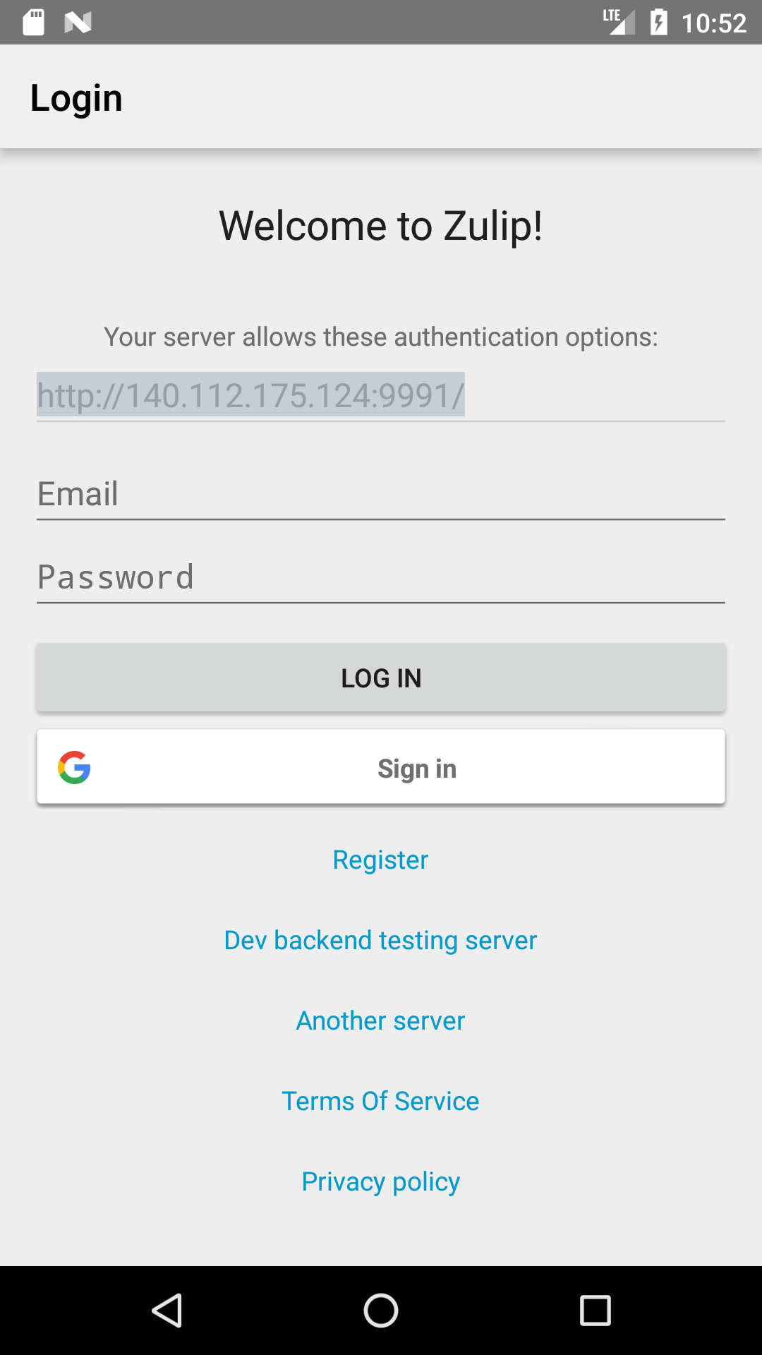
Demonstration(/)
loginUI

Slide 35
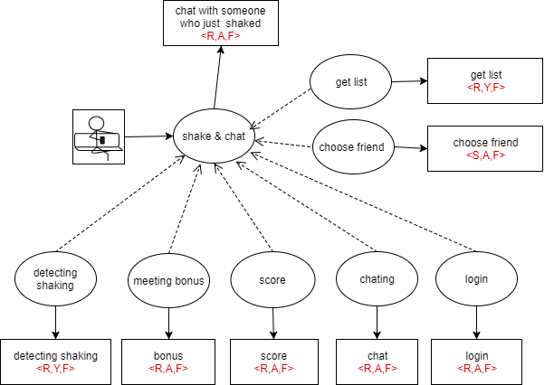
Goal-driven Use Case Diagram

Slide 36
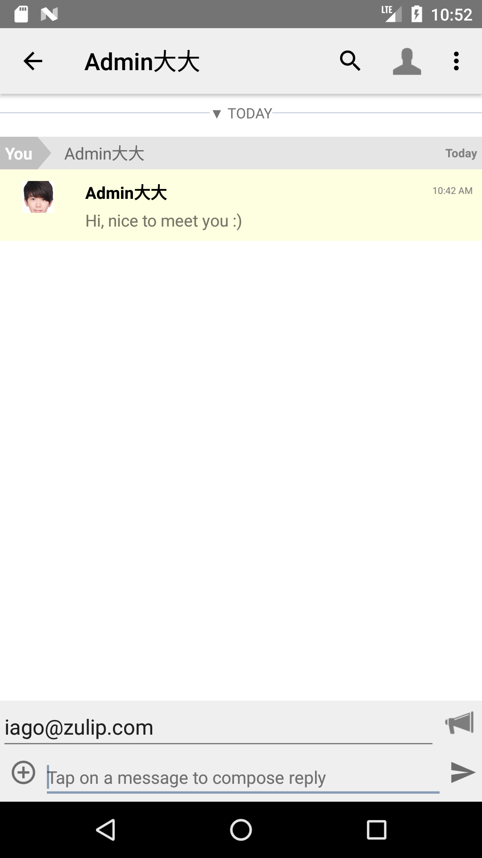
Demonstration(/)
chatUI

Slide 37
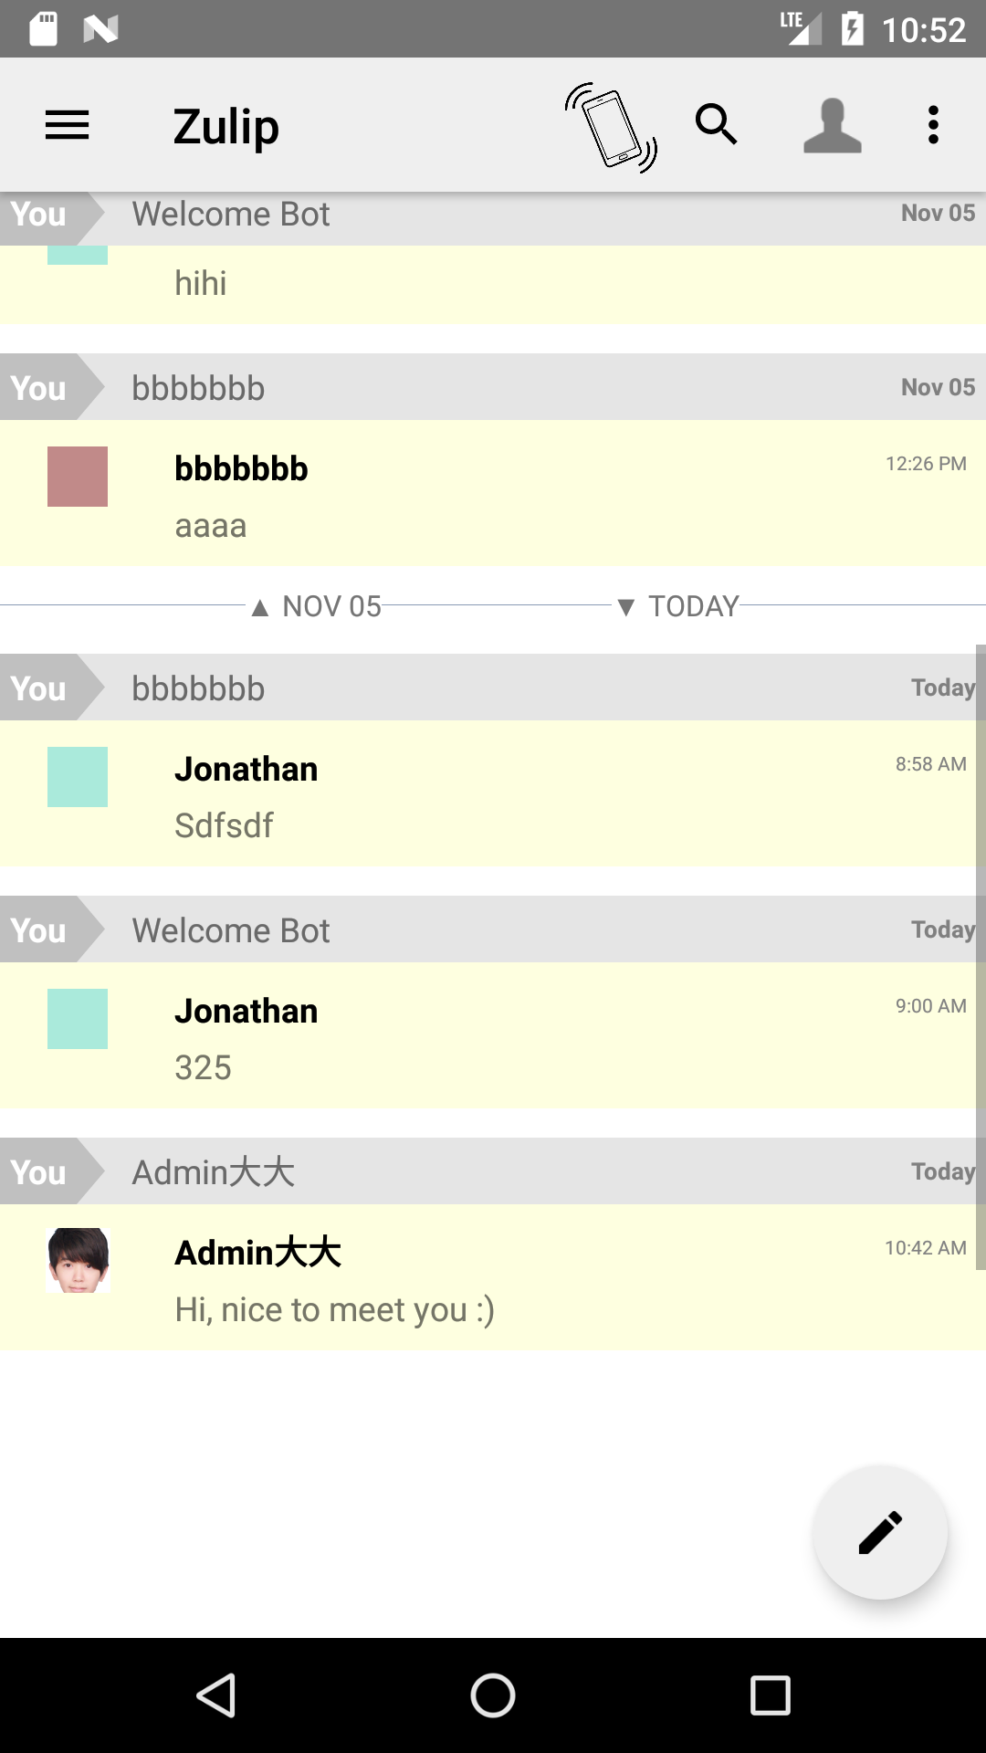
Demonstration(/)
shakeUI

Slide 38
Demonstration(/)
nearbyListUI

Slide 39
Demonstration(/)
scoreUI

Slide 40
Demonstration(/)
scoreUI

Slide 41
Demonstration(/)
scoreUI

Slide 42
WBS
confidence | 65% | z | 0.385 | divisor | 1.869 |  |  | final prediction | 97.829
task# | worst case | best case | most likely |  | avg case | sigma | sigma^2 | final work time | predicted?
Survey | 14 | 7 | 10 |  | 10.167 | 3.745 | 14.025 | 14 | v
比較IM | 2 | 2 | 2 |  | 2.000 | 0.000 | 0.000 | 3 | x
測試IM可架設性 | 5 | 2 | 3 |  | 3.167 | 1.605 | 2.576 | 2 | v
需求分析 | 7 | 3 | 5 |  | 5.000 | 2.140 | 4.580 | 10 | x
需求擷取 | 4 | 2 | 3 |  | 3.000 | 1.070 | 1.145 | 5 | x
訂定目標 | 3 | 1 | 2 |  | 2.000 | 1.070 | 1.145 | 2 | v
撰寫系統文件 | 7 | 4 | 6 |  | 5.833 | 1.605 | 2.576 | 10 | x
trace 系統 | 20 | 5 | 12 |  | 12.167 | 8.025 | 64.399 | 30 | x
發展系統架構 | 12 | 7 | 10 |  | 9.833 | 2.675 | 7.155 | 15 | x
資料傳輸內容設計 | 7 | 2 | 5 |  | 4.833 | 2.675 | 7.155 | 3 | v
搖一搖系統設計 | 7 | 3 | 6 |  | 5.667 | 2.140 | 4.580 | 2 | x
定位系統設計 | 7 | 2 | 5 |  | 4.833 | 2.675 | 7.155 | 2 | v
後端系統設計 | 7 | 4 | 5 |  | 5.167 | 1.605 | 2.576 | 2 | x
定位系統實作+測試 | 5 | 3 | 4 |  | 4.000 | 1.070 | 1.145 | 4 | v
搖一搖系統實作+測試 | 5 | 3 | 4 |  | 4.000 | 1.070 | 1.145 | 1 | x
後端系統實作+測試 | 5 | 3 | 4 |  | 4.000 | 1.070 | 1.145 | 4 | v
整合系統+測試 | 6 | 3 | 5 |  | 4.833 | 1.605 | 2.576 | 7 | x
系統測試 | 4 | 2 | 3 |  | 3.000 | 1.070 | 1.145 | 6 | x
 | 127 | 58 | 94 |  | 93.500 | 11.235 | 126.223 | 122

Slide 43
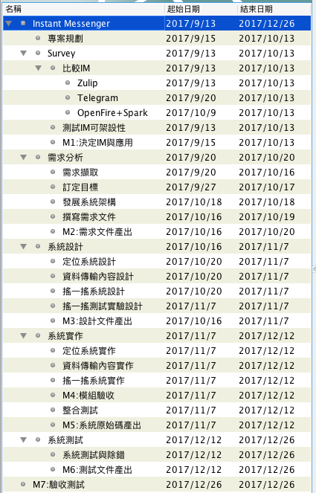

Slide 44
Code statistics
Original Java Code in Zulip-android
Code: 13599
File: 126
Modified Java Code in Zulip-android
Cod :14310
File: 133

